Slide 1
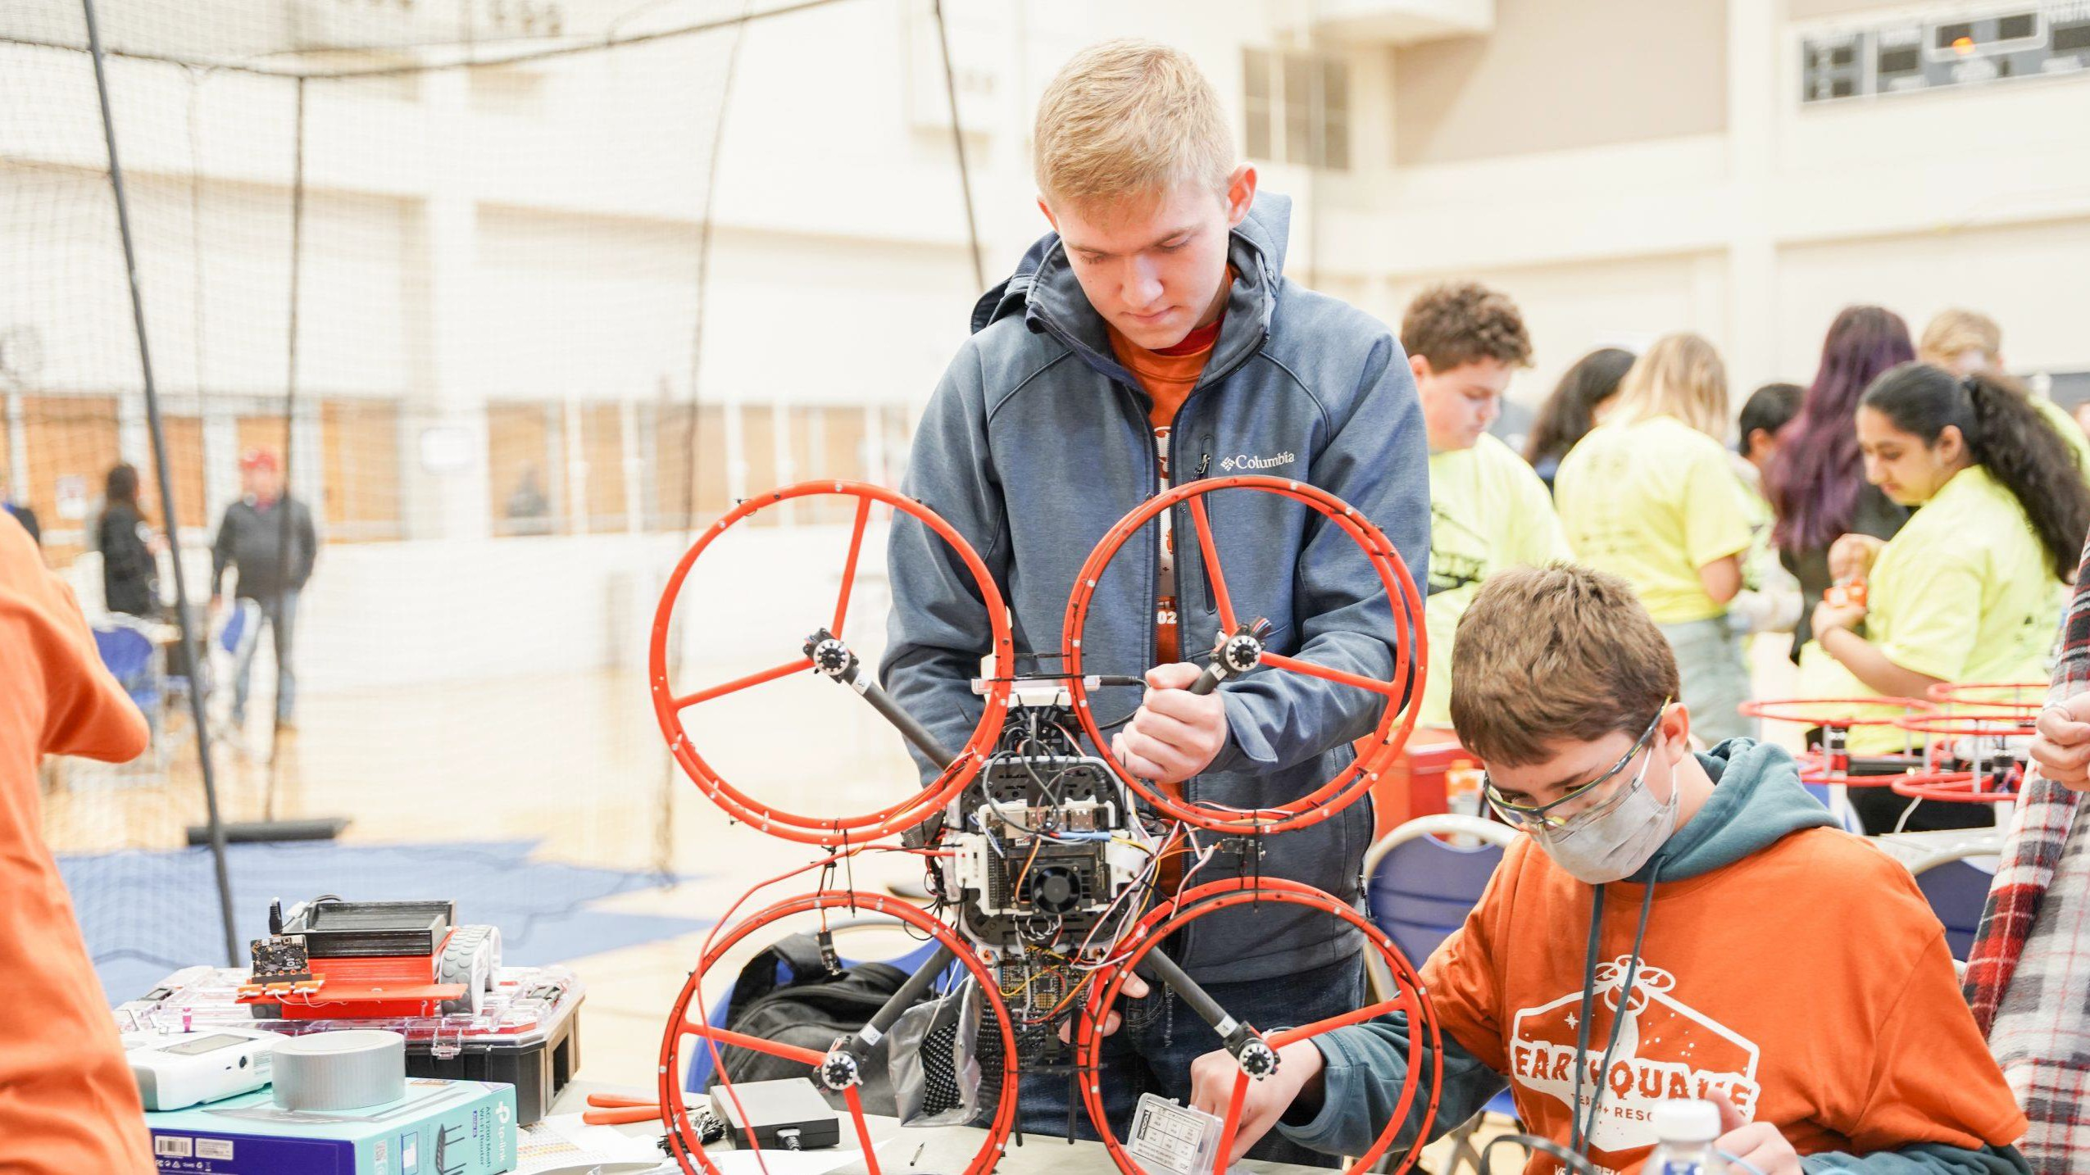
BELL ADVANCED VERTICAL ROBOTICS COMPETITION
NCTX UPDATE
1

Slide 2
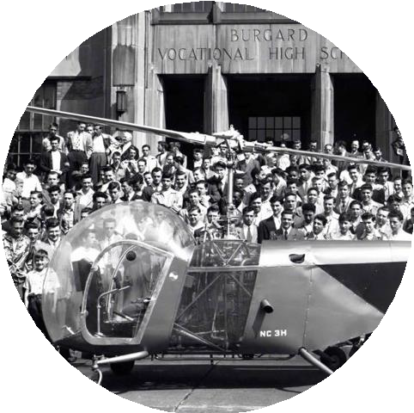
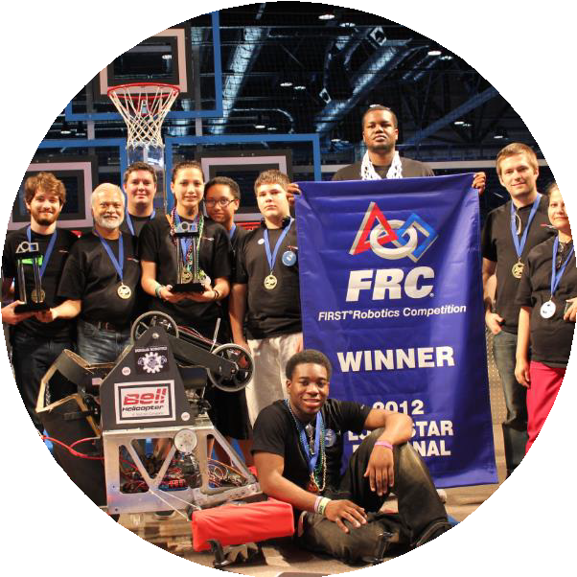
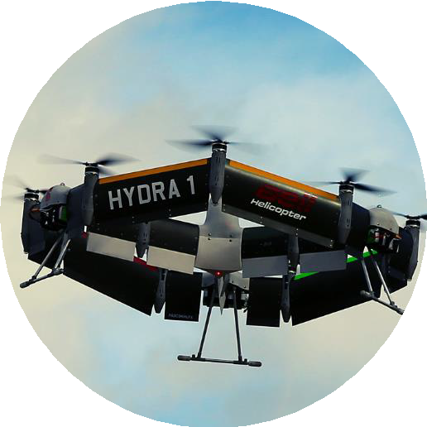
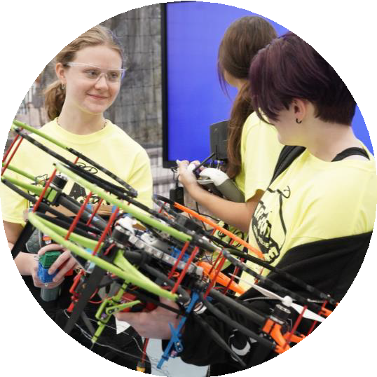
BELL ADVANCED VERTICAL ROBOTICS COMPETITION
WHY
LEGACY OF
STEM SUPPORT
SUCCESSFUL
FIRST ROBOTICS MODEL
EMERGENCE
OF NEW TECHNOLOGY
GAP IN
STEM-BASED COMPETITIONS
2017
17 Students, 2 Schools
2022
650+ Students, 70+ Schools
CREATING VALUE FOR STUDENTS, EDUCATORS, AND BELL

Slide 3
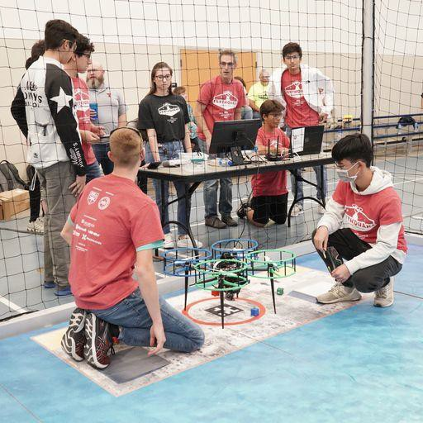
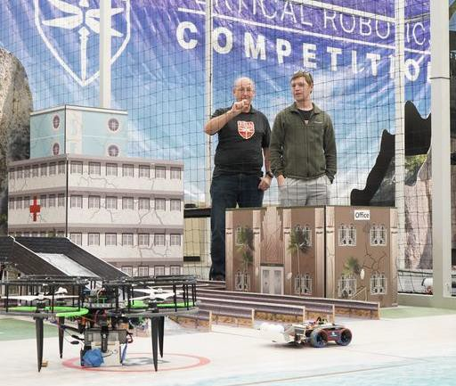
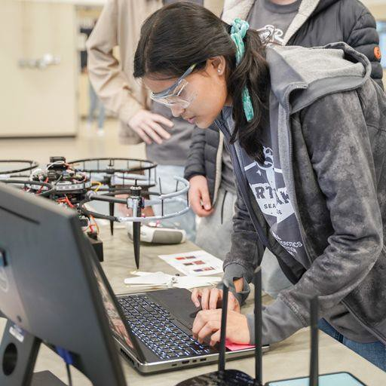
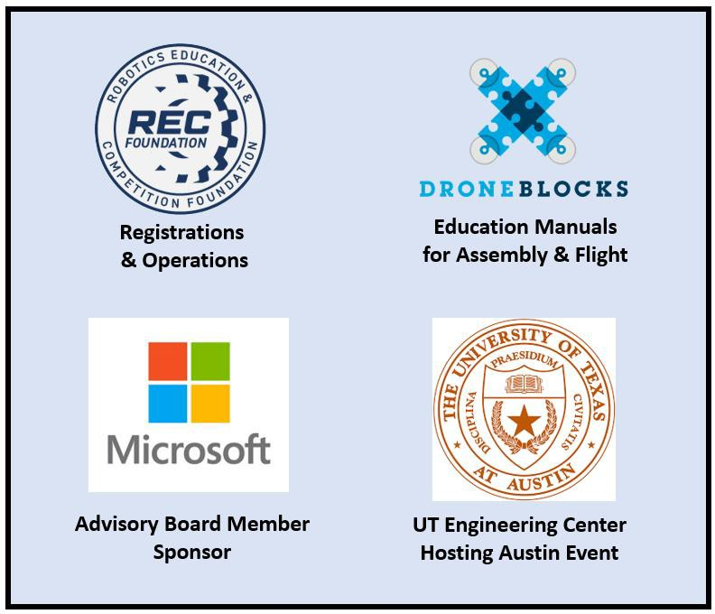
BELL ADVANCED VERTICAL ROBOTICS COMPETITION
WHAT IS THE
Extensive Team Engagement
7 Students
Collaboration
Diversity of roles
Curated Curriculum
Multidiscipline Learning
Real World Mission Scenarios
On-Demand Mobility
Search & Rescue
Firefighting
Cutting Edge Technology
Computer Vision
3 Flight Computers
QR Codes for Autonomy
GPS-denied Environment
Partnerships for Execution
Leveraging non-profits to scale cost effectively
NCTX Consortium
Teaming with Universities
High School Recruiting for Universities
College Recruiting for Bell
Engaging with Industry
Technology
Workforce Development
Air & Ground Integration
Multi-Modal
Open-Source Technology
GitHub & GitBook
Robust Assembly Manual
On-Line Support Forum
UNIQUE 10-WEEK HIGH SCHOOL STEM COMPETITION

Slide 4
IMPACT
BELL ADVANCED VERTICAL ROBOTICS COMPETITION
"...The experience of the Bell drone competition is what first got me interested in Aerospace..."
"...the Bell competition has capabilities that no other competitions have..."
"...We partnered with Bell to encourage curiosity, build confidence, and prepare high school students for promising careers...“
"...60 click throughs all the way to the admissions application. A great collaboration!"
"...AVR is a transformational competition because it develops both soft skills...and hands-on technical skills"
NATIONWIDE REACH: Texas, Michigan & Washington DC

Slide 5
2022 Schedule: Firefighting Challenge!
Overview
Kickoff Event – 27 Aug 2022
10 Weeks for Teams to Design/Build/Test
3 Weekends for Competition Events (First 3 weekends of Nov)
1 Weekend for Championship Event (Dec)
Teams can sign up for a 2nd competition event
Competition Schedule
2022 Season – 4 Cities: Multiple cities/weekend
1st Weekend – Nov 5/6 : Austin & Michigan
2nd Weekend – Nov 12/13 : UT Arlington & Michigan (2nd event)
3rd Weekend – Nov 18/19/20 : UT Arlington (2nd event) & Washington DC Championship Round – Dec 3: Bell Flight Research Center

Slide 6
2022 Bell AVR Documentation & Resources
Information below available on the REC Foundation Website
Official Game Manual: https://RoboticsEducation.org/BellManual 25
Official Game Animation: https://youtu.be/iJml75fcsLg 5
Assembly Guide: https://bellflight.github.io/AVR-2022 18
Source Code Repo: https://github.com/bellflight/AVR-2022 4
Field CAD models: STEP download 12 and OnShape Parasolid 12
Open-Source Forum: https://www.bellavrforum.org/

Slide 7
